Slide 1

CENSUS REPORTING SYSTEM
By
(B.Akshitha)

Slide 2
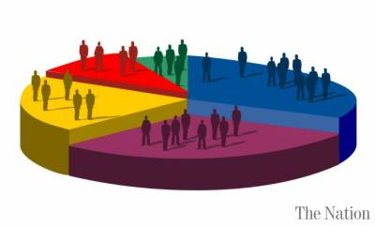
CENSUS:
A census is the procedure of systematically acquiring and recording information
about the members of a given population.
Censuses typically began as the only method of collecting national demographic data,
and are now part of a larger system of different surveys.
OBJECTIVE:
The purpose of this project is to gather information about general population in order to present a full and reliable picture of population in Cities- its Demographic and housing conditions, social and economic characteristics.
This project is essential for City wise comparisons of any kind of Statistics.

Slide 3





PROJECT FLOW
EXTRACT
R
E
P
O
R
T
S
Heterogeneous Sources i.e. operational data (Flat files)
TRANSFORM
Reports Based On
Tools
Data warehouse (Oracle)
LOAD

Slide 4
SCHEMA DESIGN:
The project follows the start schema approach.
The Dimension tables are :
(1)City.
(2)Education.
(3)Occupation.
Fact Tables are :
(1)Fact Census Occupation.
(2)Fact Census Education.

Slide 5
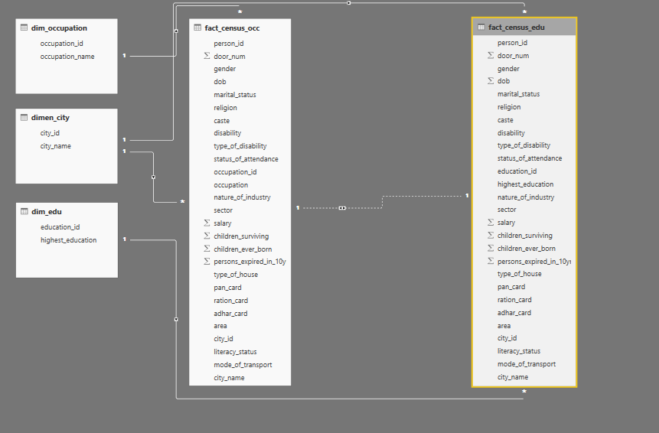
STAR SCHEMA

Slide 6
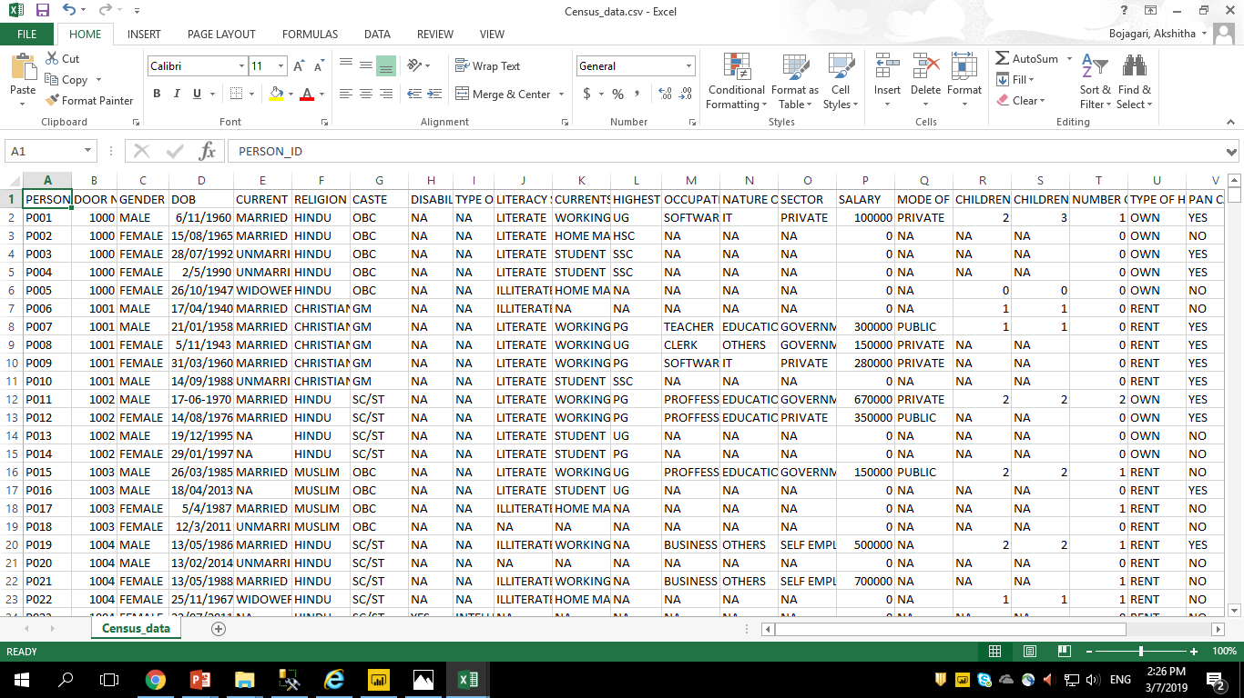
CSV FILE OF CENSUS REPORTING SYSTEM

Slide 7
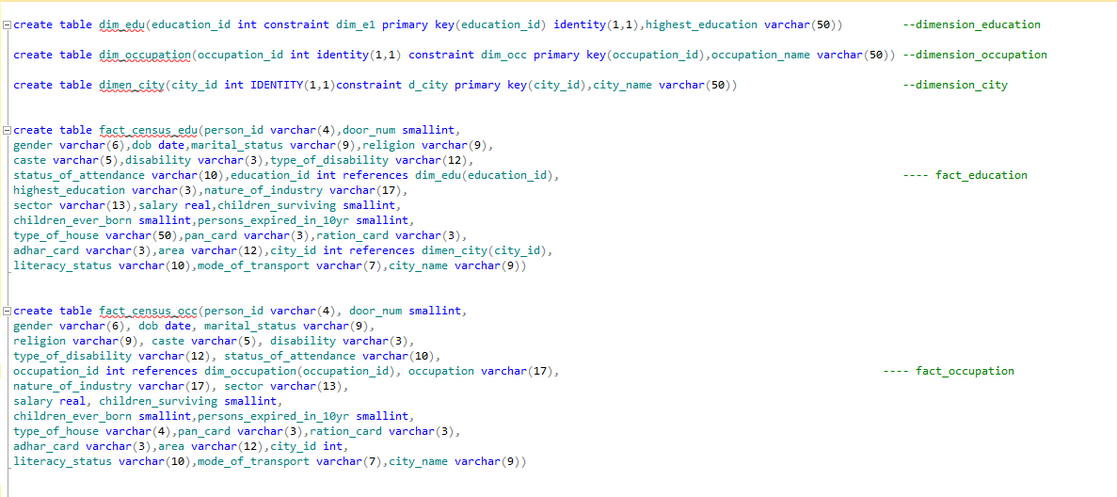
SQL QUERIES TO CREATE DIMENSION AND FACT TABLES

Slide 8
DIMENSION TABLES

Slide 9
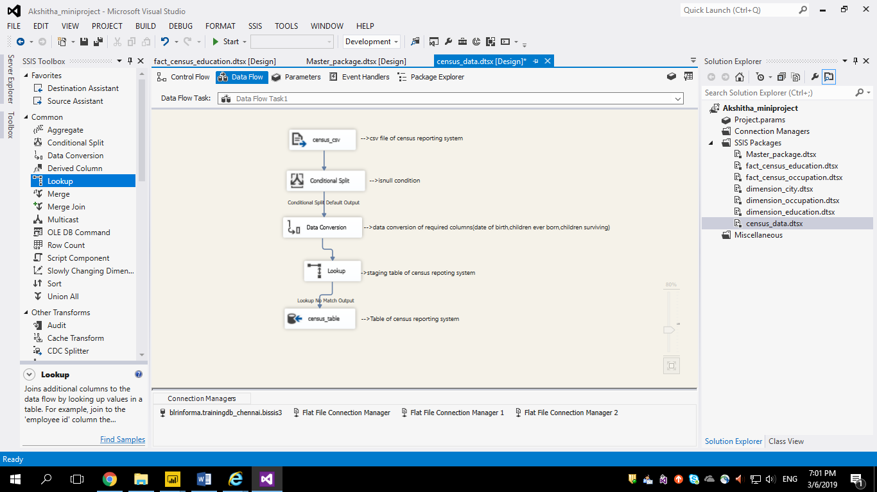
→STAGING TABLE(CENSUS)

Slide 10
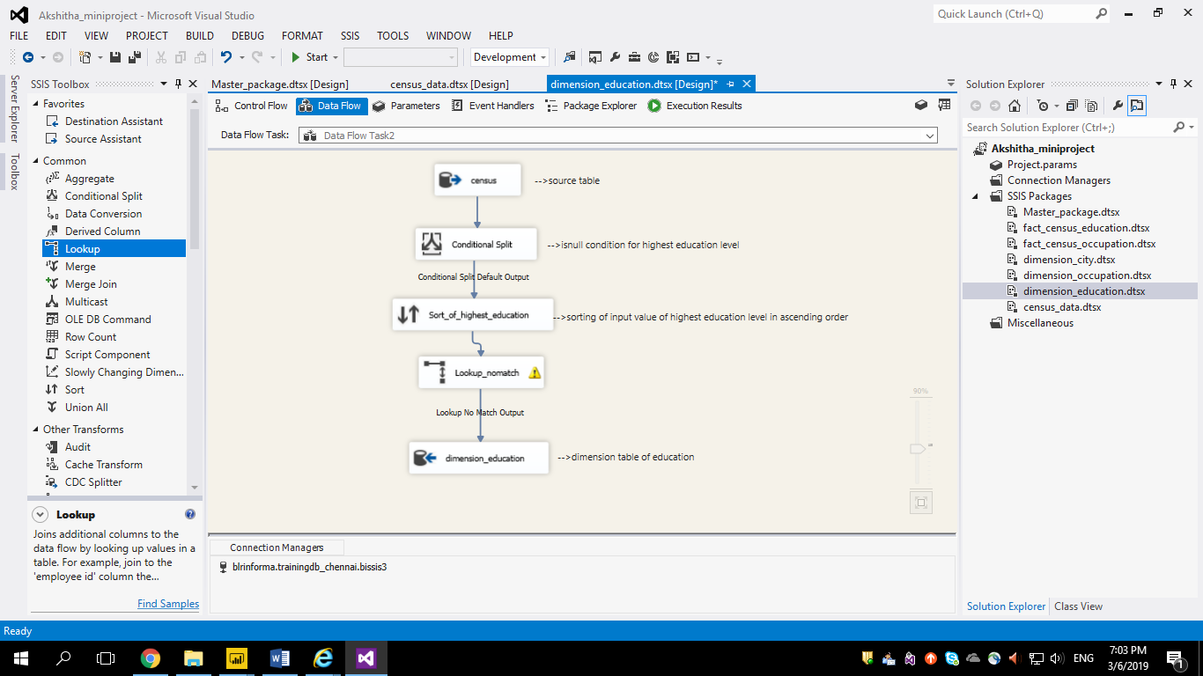
(1)DIMENSION_EDUCATION

Slide 11
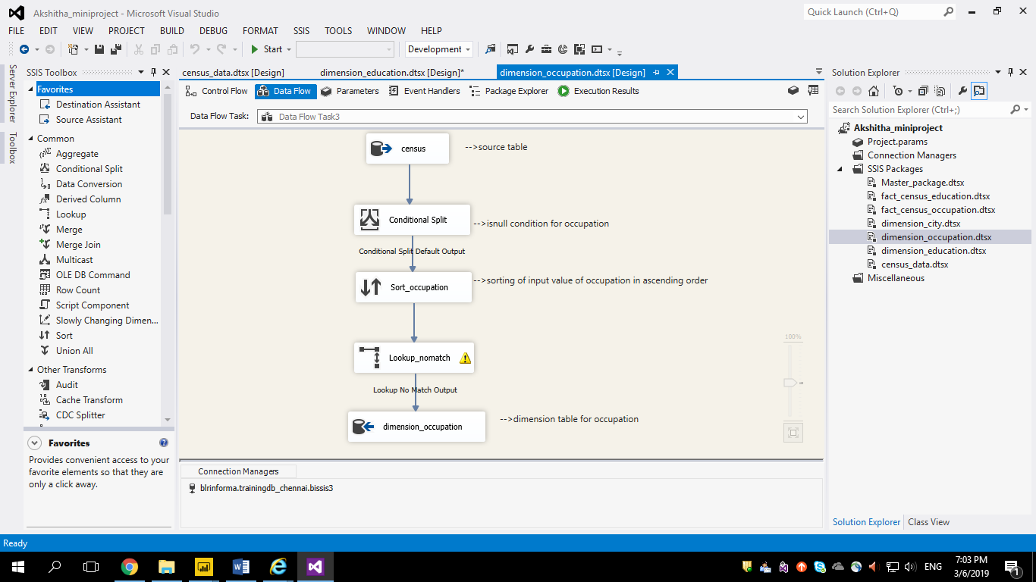
(2)DIMENSION_OCCUPATION

Slide 12
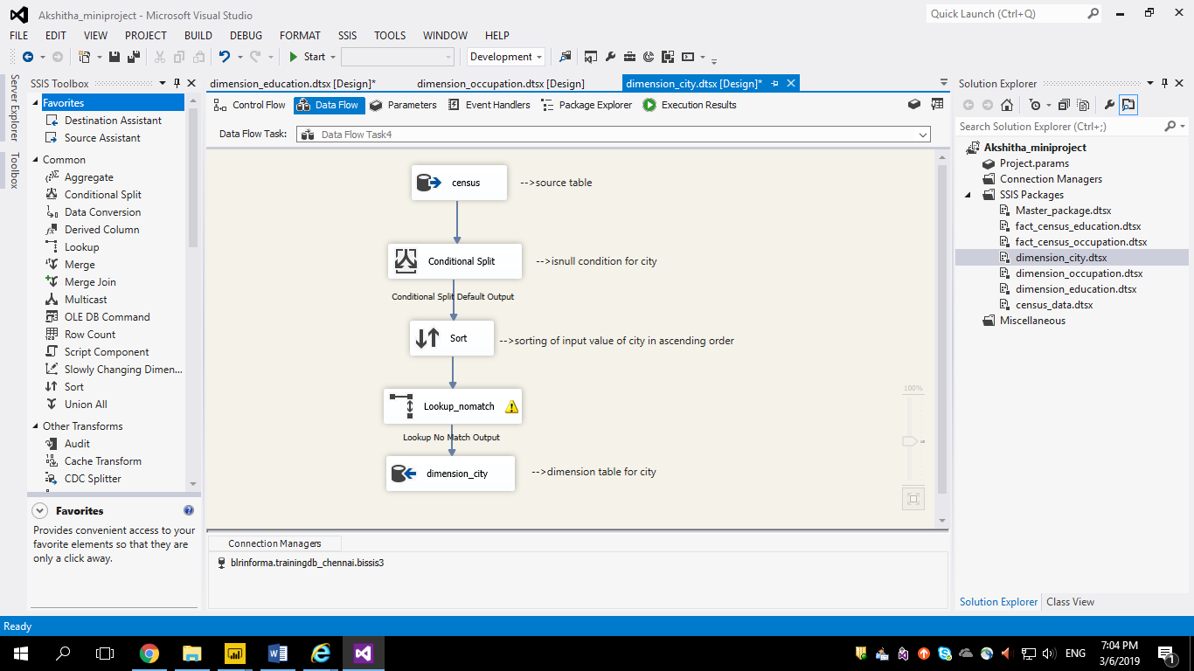
(3)DIMENSION_CITY

Slide 13
FACT TABLES

Slide 14
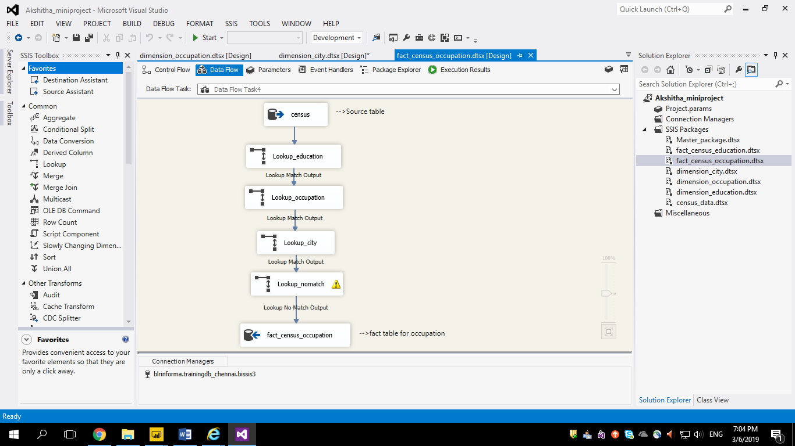
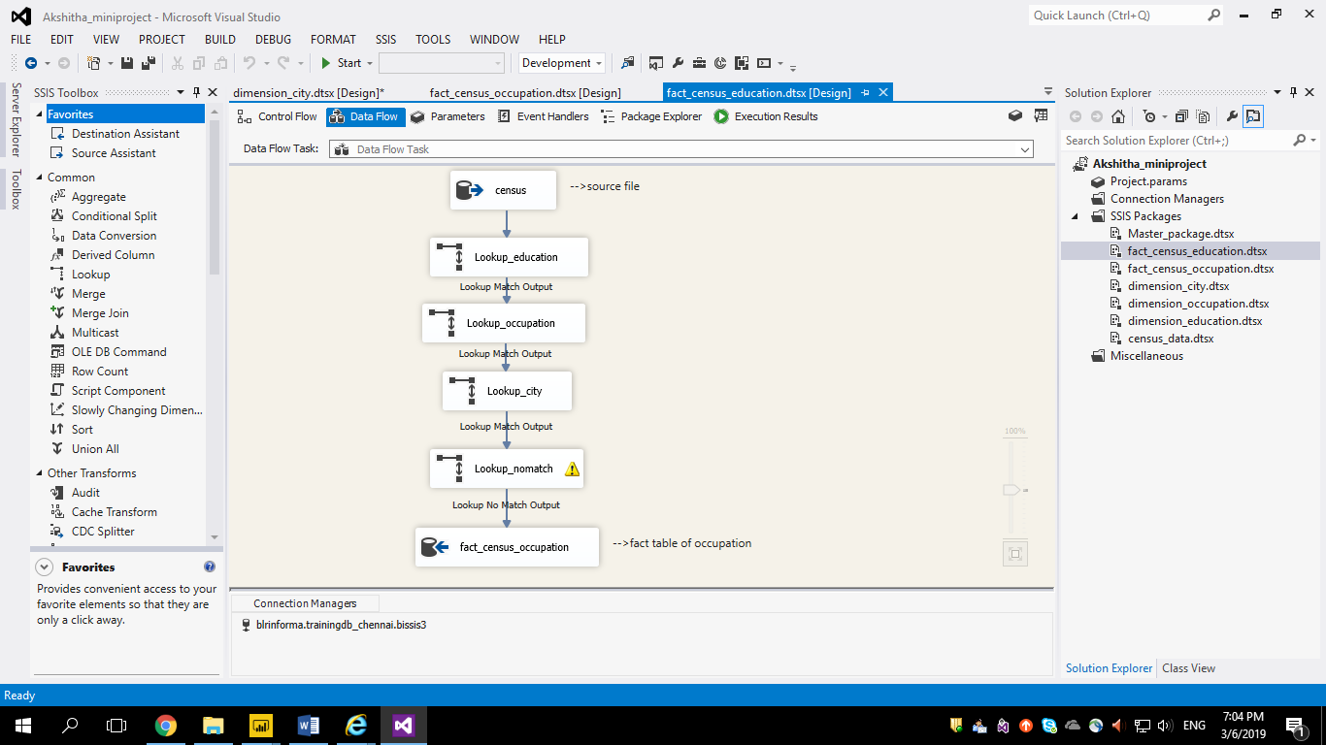
(1)FACT_CENSUS_EDUCATION
(2)FACT_CENSUS_OCCUPATION

Slide 15
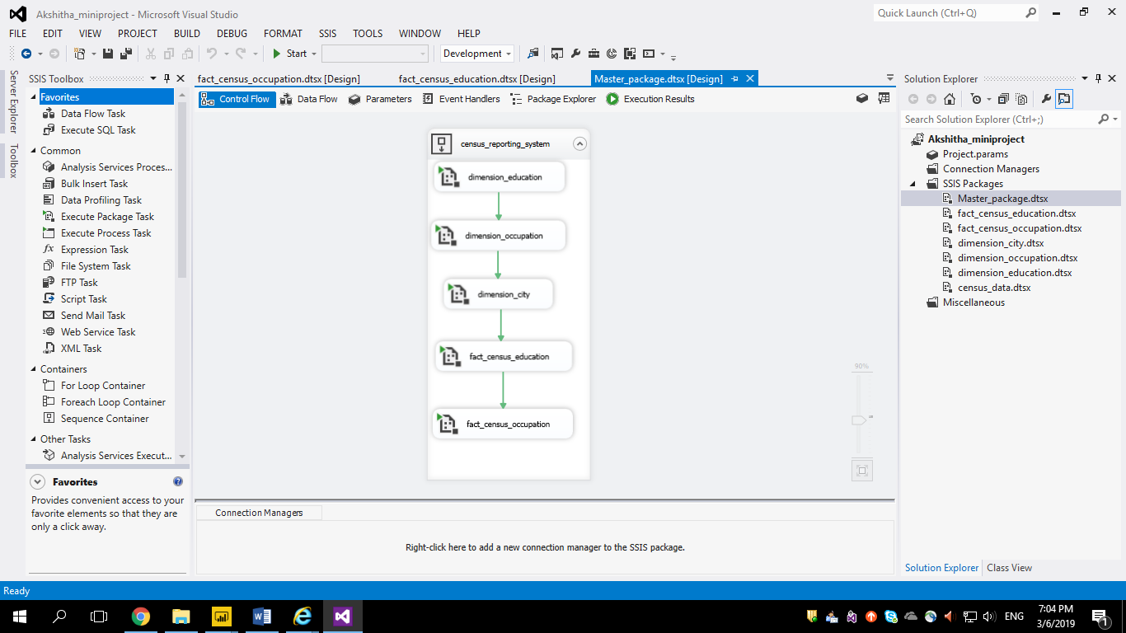
MASTER PACKAGE

Slide 16
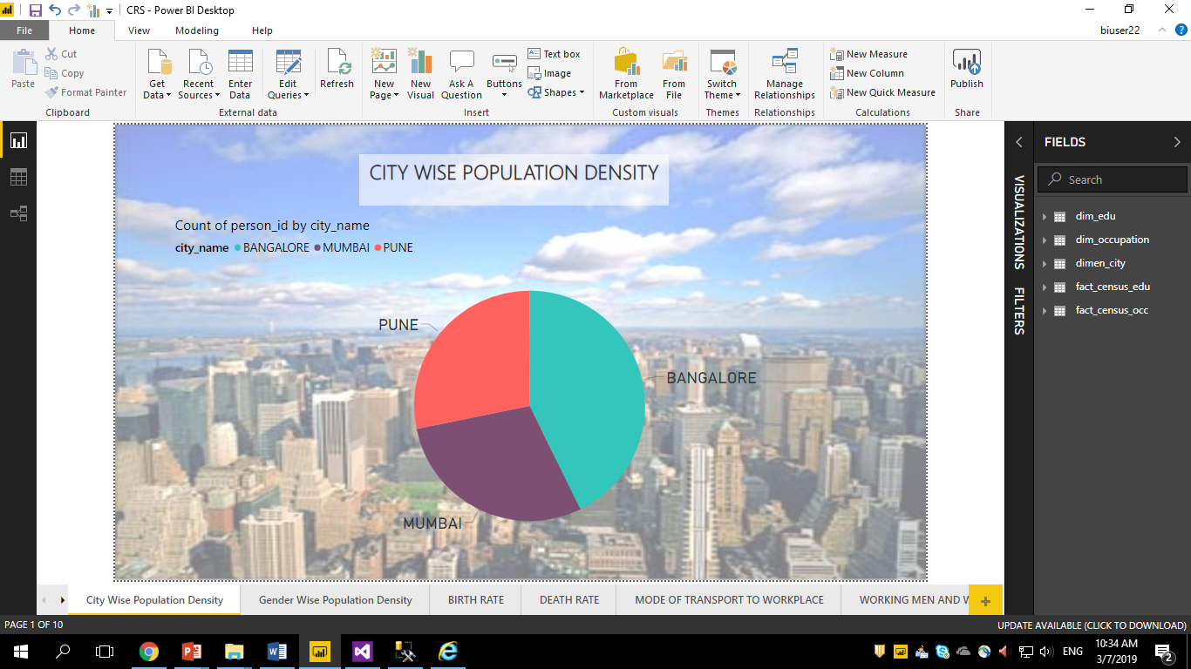
REPORTS

Slide 17
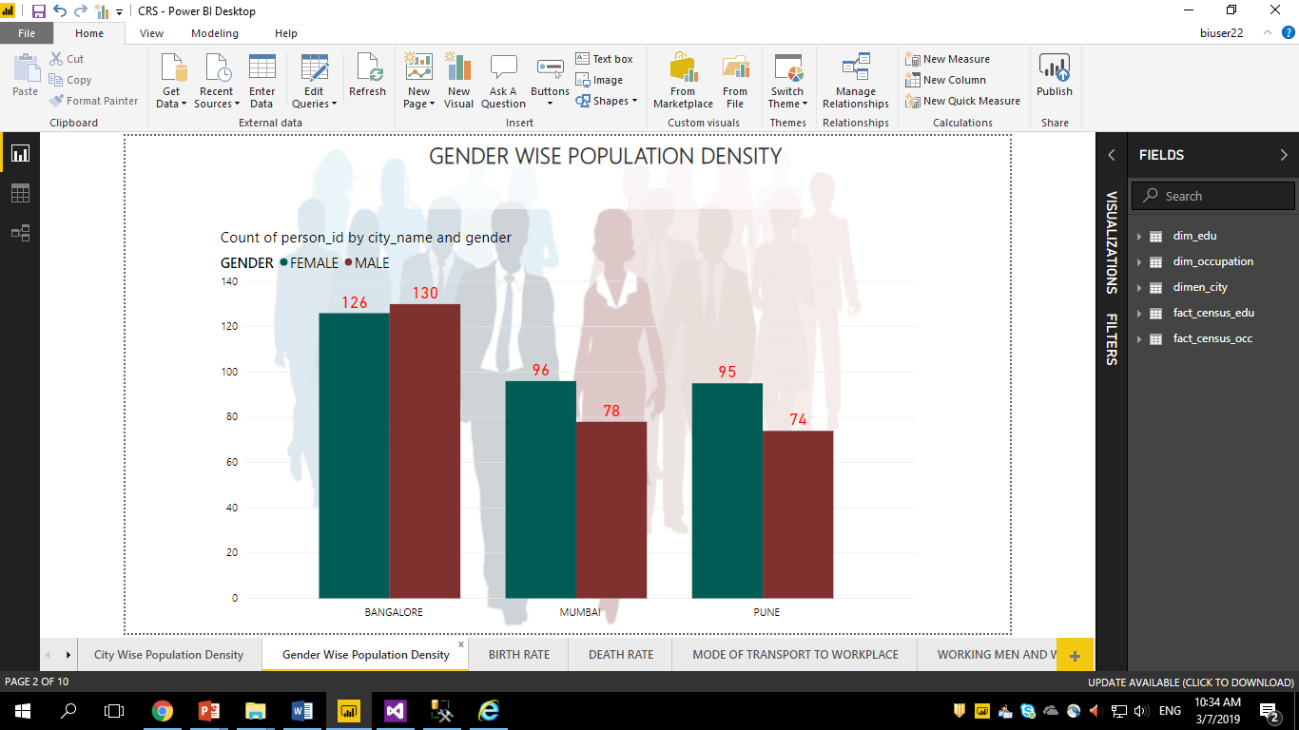

Slide 18
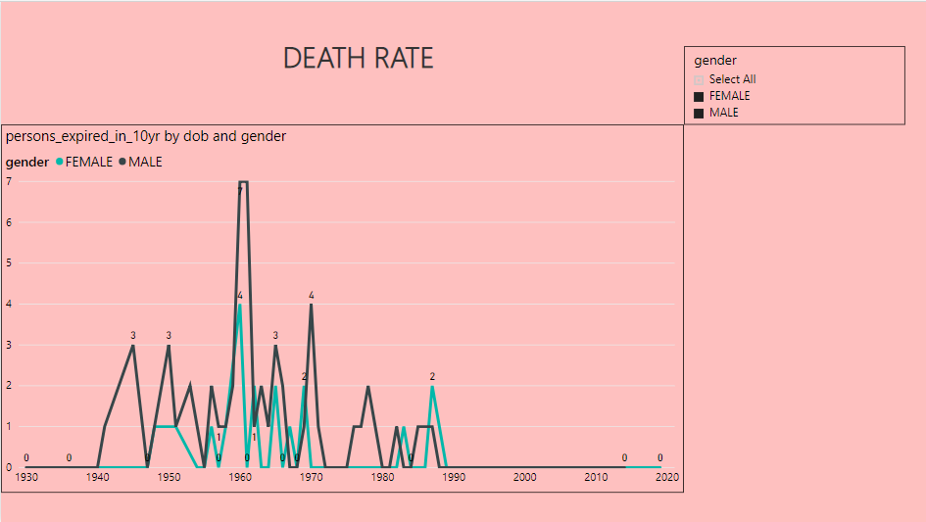

Slide 19
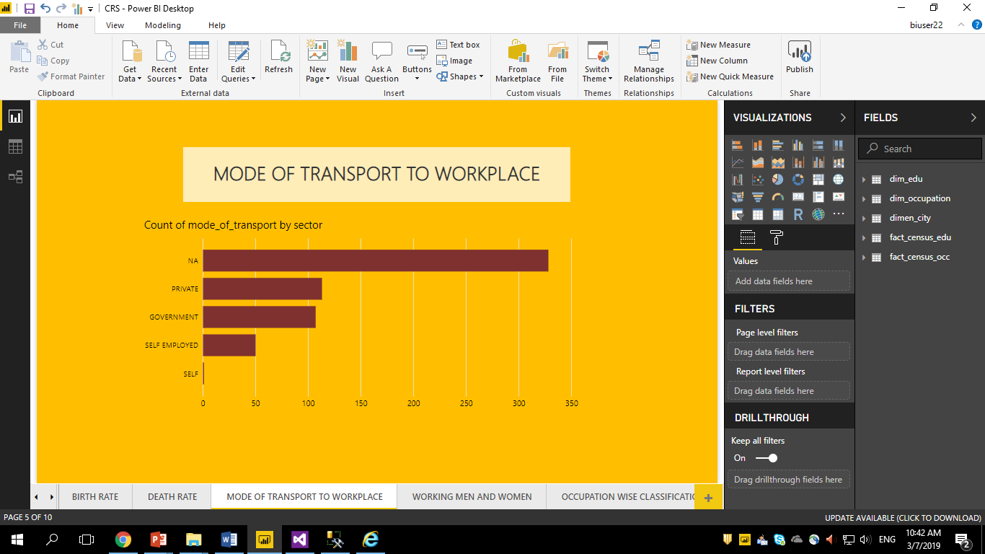

Slide 20
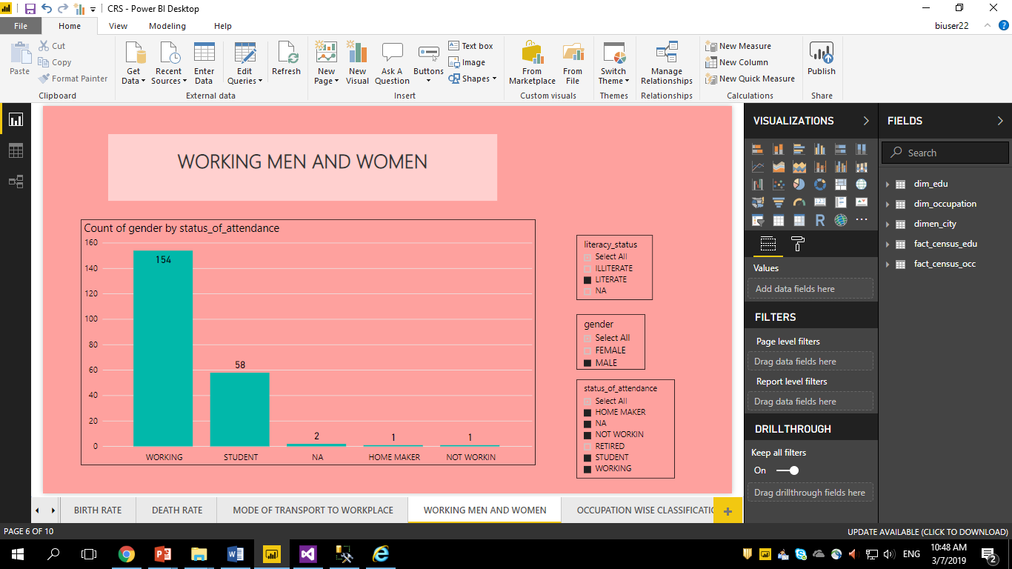

Slide 21
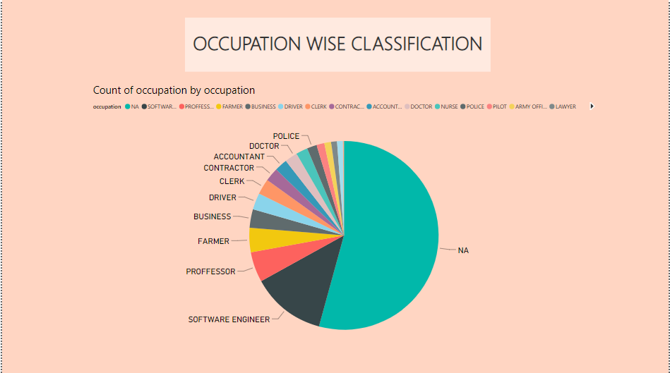

Slide 22
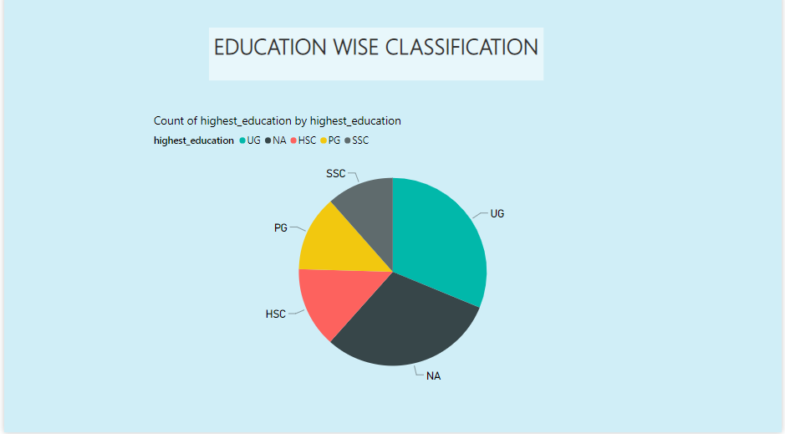

Slide 23
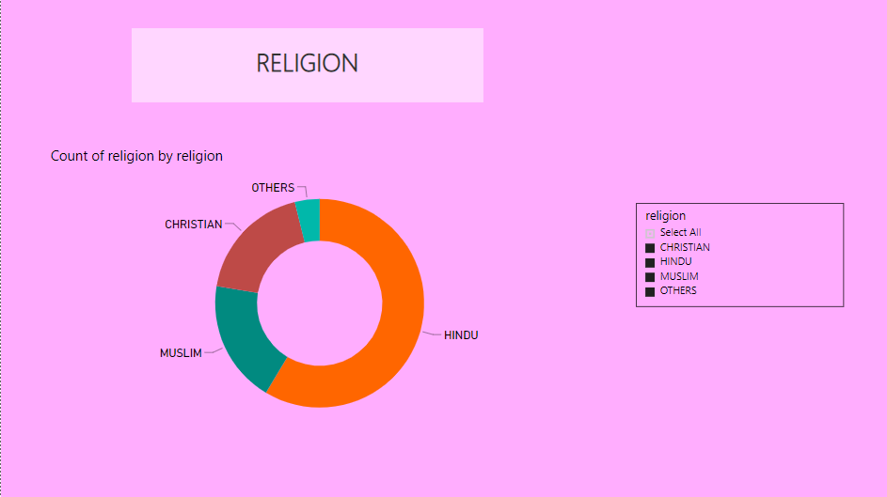

Slide 24
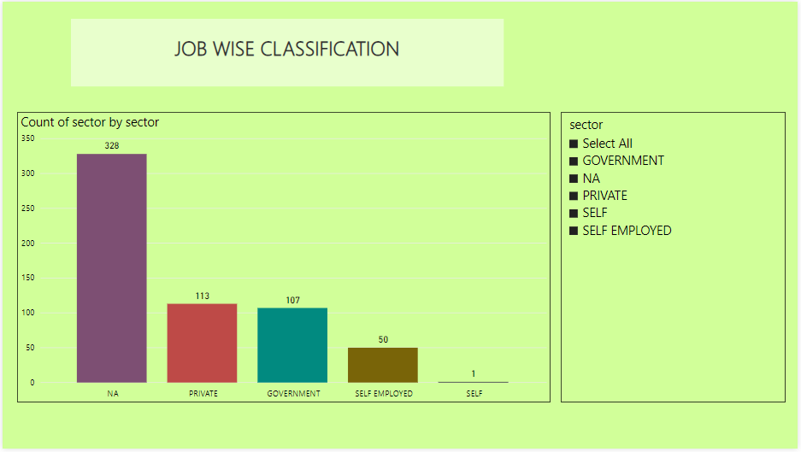

Slide 25
THANK YOU

